Slide 1
Choosing the best location to build a new Italian Restaurant in NYC

Slide 2
Deciding the best place is important
The City of New York, is the most populous city in the United States.
Throughout its history, New York City has been a major point of entry for immigrants.
With New York's diverse culture , comes diverse food items. There are many restaurants in New York City, each belonging to different categories like Chinese ,Italian, Indian , French etc.
Choosing the best location is important as there is a lot of competition and with less competition, a business can thrive more.

Slide 3
Data Acquisition and Cleaning
New York city data scraped from the New-York-dataset.
NYC Venue data scraped using FourSquare-API.
Demographic data from Wikipedia.
NYC Venue data cleaned to display only Italian Restaurants.
Raw data has 315 Italian restaurants across NYC.
Demographic data cleaned using beautifulsoup.

Slide 4
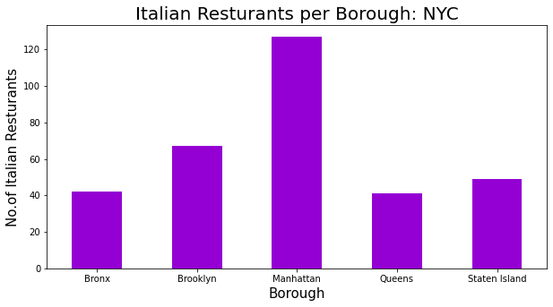
Number of Italian Restaurants in each Borough

Slide 5
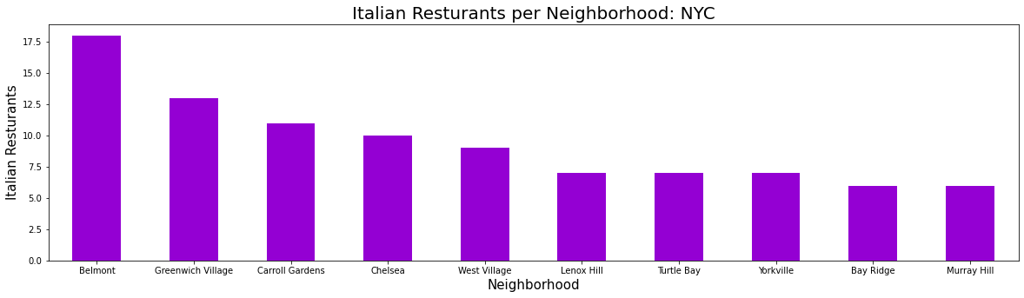
Top 10 Neighborhoods based on number of Italian Restaurants

Slide 6
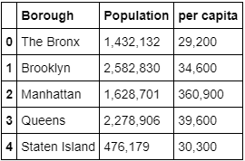
Demographic stats to choose borough
Based on this data, Queens was chosen as the borough as it has 2nd highest population and per capita income.

Slide 7
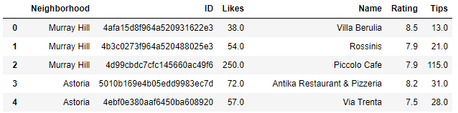
Restaurant Ratings obtained using FourSquare API
*Note: This is just the head of the DataFrame

Slide 8
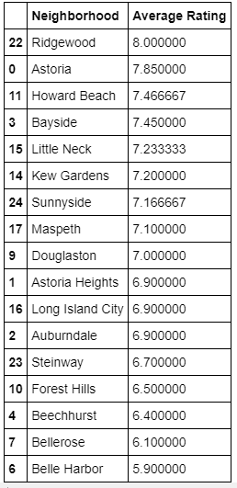
Average Rating of Italian Restaurants in Queens Neighborhoods

Slide 9
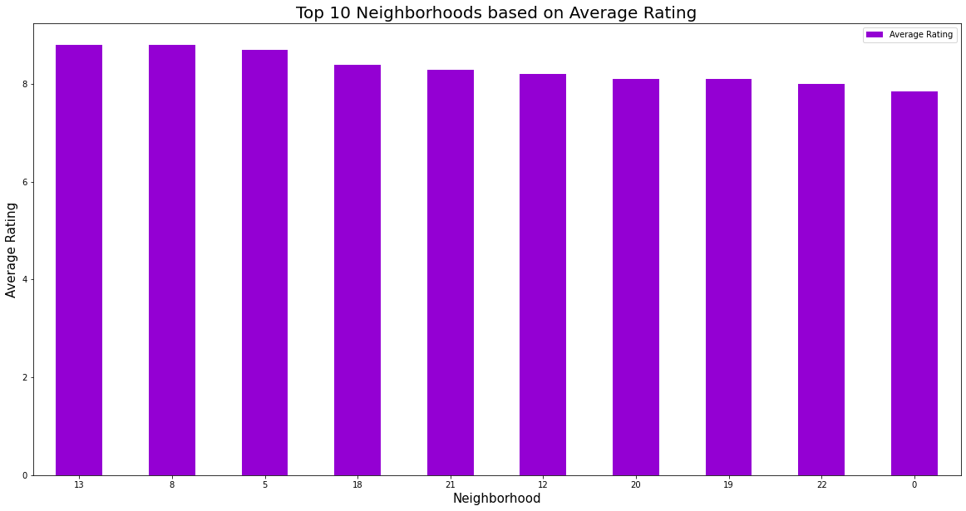
Top 10 Neighborhoods based on Average Rating

Slide 10
Conclusion and future directions
Out of the neighborhoods in Queens the ideal locations would be :
Ridgewood, Kew Gardens , Maspeth , Douglaston , Astoria Heights , Long Island City , Steinway , Forest Hills , Beechhurst and Belle Harbor
Final decision on optimal restaurant location will be made by stakeholders based on specific characteristics of neighborhoods like attractiveness of each location, levels of noise / proximity to major roads, real estate availability etc.

